Slide 1
BITCOINS
The Byzantine Fault Tolerance
Ajay Pal Singh
Vishrut Sharma
Vu Lee

Slide 2
Agenda
Introduction to Bitcoin
Motivation Behind Bitcoin
What is Distributed Consensus
Digging deeper into Bitcoin
Transactions
Block Chain
Bitcoin Mining
Proof-of-Work
Conclusion
Notes:
What common among all of us??
Food Shelter and Clothes..
And Money..
Bitcoin forces you to ask a question.. Are you satisfied with your current financial instution?

Slide 3
Introduction
Bitcoin is the first implementation of a concept called "cryptocurrency“
The Idea: A new form of money that uses cryptography to control its creation and transactions, rather than a central authority
Satoshi Nakamoto (?)
Notes:
1998 by Wei Dai

Slide 4

What is Bitcoin
A consensus network
First Decentralized Peer-to-Peer Payment Network that is powered by its Users with No Central Authority or Middlemen.
Notes:
The term ‘consensus’ simply refers to a collective decision-making process, or an agreement between different people over what is true or false.

Slide 5
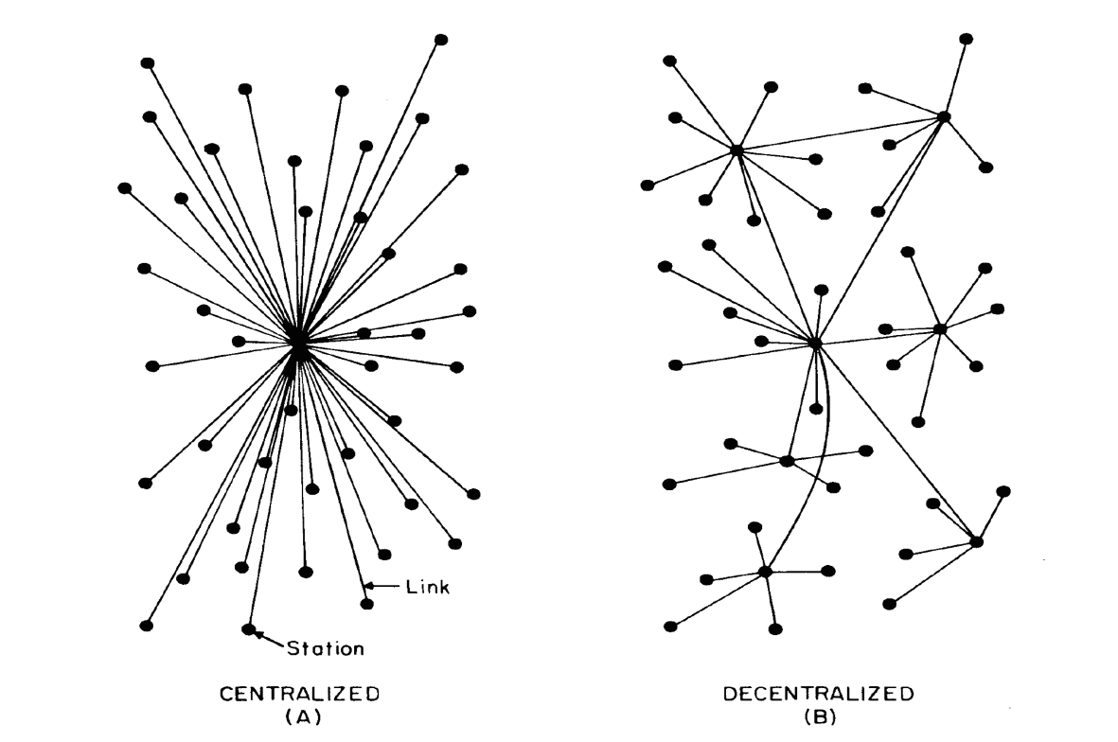
What is Bitcoin
A consensus network
First Decentralized Peer-to-Peer Payment Network that is powered by its Users with No Central Authority or Middlemen.
Notes:
Decentralized computing is the allocation of resources, both hardware and software, to each individual workstation, or office location.

Slide 6
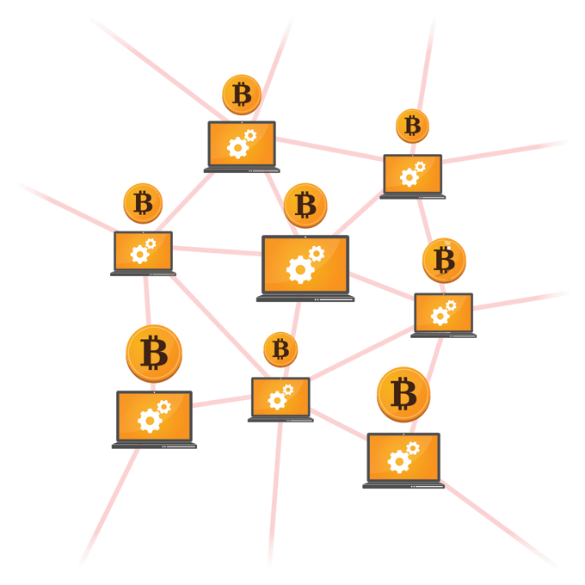
What is Bitcoin
A consensus network
First Decentralized Peer-to-Peer Payment Network that is powered by its Users with No Central Authority or Middlemen.
Notes:
From one account to another individual's account via the Internet..
a P2P network is created when multiple PCs are connected and share resources without going through a separate server computer

Slide 7
What is Bitcoin
A consensus network
First Decentralized Peer-to-Peer Payment Network that is powered by its Users with No Central Authority or Middlemen.

Slide 8
Motivation Behind Bitcoin
Transferred directly from person to person
Much lower transaction fees
Could be used in any country
Account can’t be frozen
Easy to buy and spend bitcoins
Notes:
For users it’s just a mobile app or computer program that provides a personal Bitcoin wallet and allows a user to send and receive bitcoins with them

Slide 9
Byzantine Generals Problem
Imagine a Byzantine army has encircled a city.
The army has many divisions, each division has its own general.
All generals communicate with each other through messages.
A message can be either “Attack” or “Retreat”.
There might be traitors among generals.
The goal is to reach an agreement to attack or retreat.
A common problem in distributed systems.

Slide 10
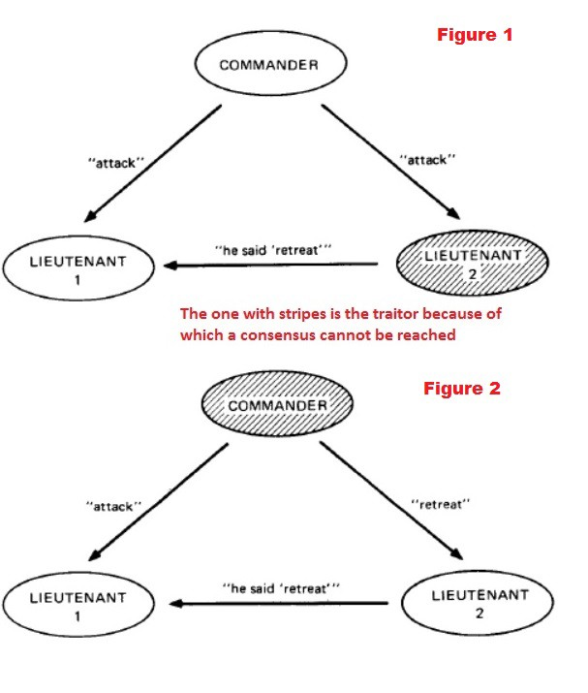
The traitor can intentionally send a forged message or pass a wrong message to another general.

Slide 11
How Bitcoin fits in Byzantine Problem
We need to make sure all participants’ file records are correct and consistent.
Any file record cannot be updated with wrong values.
Bitcoin helps solve the Byzantine problem in distributed systems.

Slide 12
What is problem of distributed consensus?
"Consensus" is the problem of getting members of a network to agree on something, e.g. a value.
Agree on how many units of the currency each member holds at all times, in order to prevent members from double spending
Mining
Miners
Blocks containing series of transactions
Find a valid proof of work

Slide 13
Process of reaching consensus
New transactions are broadcast to all nodes in the network.
Miner nodes collect the new transactions into a block.
Miner nodes try to find a proof of work for the block.
When a miner node finds a proof of work, it broadcasts it to all nodes in the network.
Receiving nodes validate the new block and then start work on the next block, containing transactions that have not yet been placed in a block.
The node that found the block is rewarded with some new Bitcoins, and also the value of the transactions fees for the transactions in the block.

Slide 14
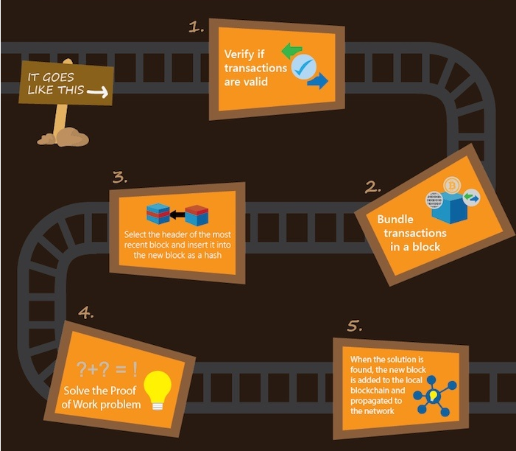
Notes:
1, signature check and ip transactions records (unspent ) : checkedby all nodes
2. Collection of transactions and its history + random number in a hash function
4. If 1 person done fraud transaction hten he will for same transaction

Slide 15
Digging deeper into Bitcoin
Transactions
All are public but anonymous
Mining nodes collect the transaction in blocks
Blockchain
A Block Chain is a public ledger of all Bitcoin transactions that have ever been executed.
Simply, a chain of blocks
Bitcoin Mining
Proof-of-Work

Slide 16
Bitcoin Mining
Bitcoin mining is the process of adding transactions to Bitcoin's public ledger of past transactions or blockchain.
It serves 2 purposes:
Confirm transactions
Generate new bitcoins
Mining is a highly competitive market
No. of miners is proportional to the security of network

Slide 17
Some interesting facts
There is a finite limit to the total number of bitcoins = 21,000,000 BTC
Till Date 15,958,500 BTC are in circulation
Let’s look at some graphs
Notes:
Between yesterday(Oct 29) and the day before 2100 bitcoins were mined
Today the combined computing power of the Bitcoin n/w is > 500 super computers combined together times 10000

Slide 18
Proof of Work
It’s a method to ensure that the information (the new block) was computationally difficult to obtain.
It costs processing power: Hardware, Energy, Time
But, easy to be verified by others
Target is adjusted to determine mining difficulty in order to keep the block generation rate constant.
Notes:
Attackers race against all other honest nodes.
Signature
Input transaction
Ordering of transactions through bock chain
Prevent fraud

Slide 19
Conclusion
Worldwide acceptance of Bitcoin has already started.
‘Bitcoin’ is a concept and Currency is just an application of Bitcoin.
Other applications of Bitcoin could be beyond our imagination.
Patents
Smart Contracts
Proof of ownership
Identity

Slide 20
References
Satoshi Nakamoto. Bitcoin: A Peer-to-Peer Electronic Cash System.
http://www.nasdaq.com/g00/article/byzantine-fault-tolerance-the-key-for-blockchains-cm810058?i10c.encReferrer=https://bitcoin.org/en/faq
https://www.cryptocoinsnews.com/approximate-hardware-bigger-bitcoin-mining-profits/
Bitcoin: The End of Money As We Know It
https://www.youtube.com/watch?v=lUF6klWuB38

